Slide 1
Soft computing
Hybrid systems

Slide 2
Hybrid Systems
Integrated architectures for machine learning have been shown to provide performance improvements over single representation architectures.
Integration, or hybridization, is achieved using a spectrum of module or component architectures ranging from those sharing independently functioning components to architectures in which different components are combined in inherently inseparable ways.
In this presentation we briefly survey prototypical integrated architectures

Slide 3
The combination of knowledge based systems, neural networks and evolutionary computation forms the core of an emerging approach to building hybrid intelligent systems capable of reasoning and learning in an uncertain and imprecise environment.

Slide 4
ANFIS
Conventional mathematical tools are quantitative in nature
They are not well suited for uncertain problems
FIS on the other hand can model qualitative aspects without employing precise quantitative analyses.
Though FIS has more practical applications it lack behind
Standard methods for transformation into rule base
Effective methods for tuning MFs for better performance index

Slide 5
ANFIS serve as a basis for constructing a set of fuzzy if-then rules with appropriate membership functions to generate the stipulated input-output pairs

Slide 6
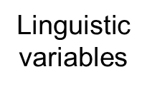

Fuzzy if-then rules and Fuzzy Inference systems
Fuzzy if-then rules are of the form IF A THEN B where A and B are labels of fuzzy sets.
Example
“if pressure is high then volume is small”

Slide 7
Sugeno model
Assume that the fuzzy inference system has two
inputs x and y and one output z.
A first-order Sugeno fuzzy model has rules as the
following:
Rule1:
If x is A1 and y is B1, then f1 = p1x + q1y + r1
Rule2:
If x is A2 and y is B2, then f2 = p2x + q2y + r2

Slide 8
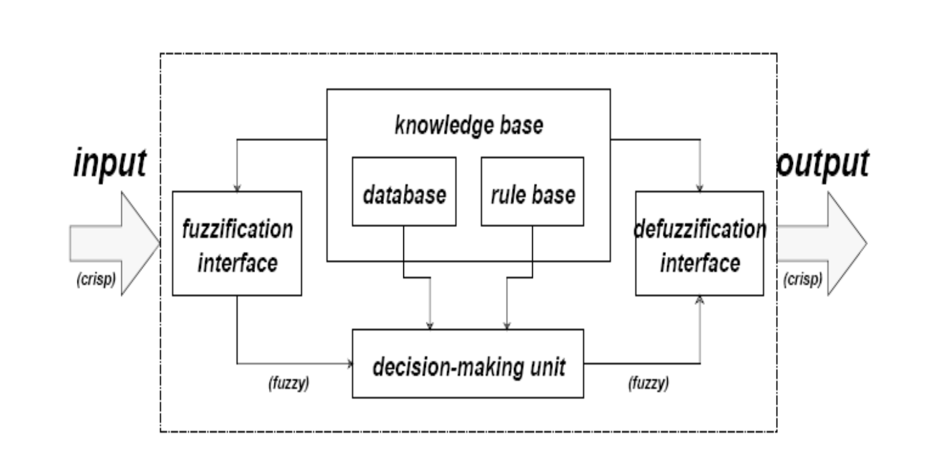
Fuzzy Inference system

Slide 9
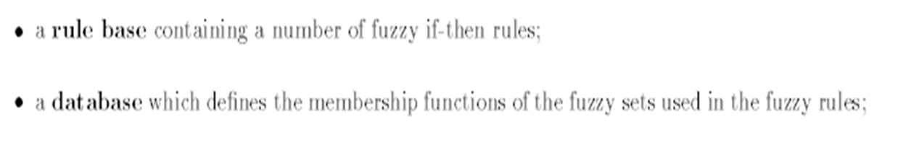
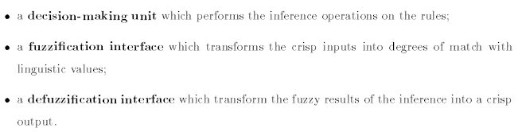
Blocks of FIS

Slide 10
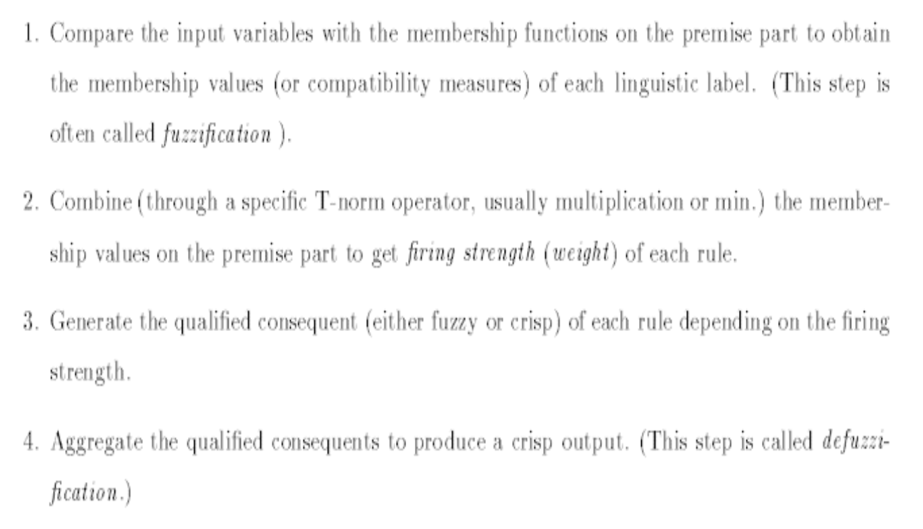

Slide 11
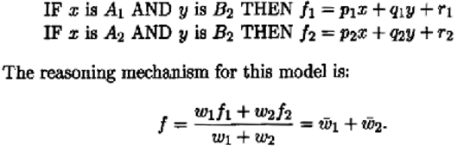
Adaptive Network-based Fuzzy Inference System
Neuro-fuzzy system that can identify parameters by using supervised learning methods
Sugeno-type fuzzy system with learning capabilities
First order model

Slide 12
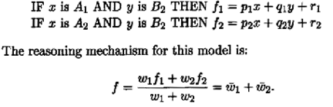
Nodes have the same function for a given layer but are different from one layer to the next

Slide 13
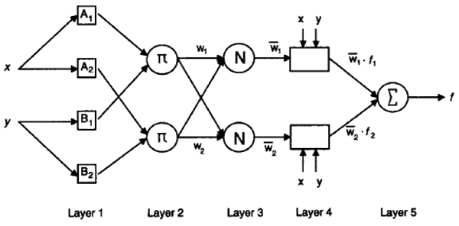

Slide 14
Learning algorithm is a hybrid supervised method based on gradient descent and Least-squares
Forward phase: signals travel up to layer 4 and the relevant parameters are fitted by least squares
Backward phase: the error signals travel backward and the premise parameters are updated as in backpropagation
Fuzzy toolbox Matlab
Mackey-Glass prediction / excellent non-linear fitting and generalization / less parameters and training time is comparable with ANN methods

Slide 15
Since a wide class of fuzzy controllers can be transformed into equivalent adaptive networks, ANFIS can be used for building intelligent controllers that is, controllers that can reason with simple fuzzy inference and that are able to learn from experience in the ANN style

